Slide 1

Predict Term Deposit
Data Science
Bank Marketing
By: Novia Wulandari
This photo by freepik.com

Slide 2
Outline
Bussiness & Data Understanding
Split data (train & test)
EDA
Chi-Square Test
Encoding Preparation
Split Xtrain and Xtest into number & categorical
Standar Scaller
A. Bussines & Data Understanding
Duplicated Data Train & Test (masing-masing)
Outliers Analysis
Missing Value Handling
Imputation data
Split into Xtrain,ytrain,Xtest,ytest
B. Data Preparation: Train & Test
C. Modelling Machine Learning
D. Evaluation and Tuning Model
E. Conclusion & Recommandation Business Insight
Decision Tree
Random Forest
XGBoost
Logistic Regression
KNN
Naive Bayes
SVM
Function Learning Curve of Model ML
Model ML Evaluation Function
Tuning Model ML with GridSearch
Tuning Model ML with RandomSearch

Slide 3
A. Data & Bussnies Understanding

Slide 4


Bussiness & Data Understanding
Banks can make money in many different ways, although in essence they are still considered lenders.
This photo by dreamstime.com
This photo by freepik.com
The interest rate that banks charge on loans
Interest paid by the bank to depositors
Bank
Source: https://corporatefinanceinstitute.com/resources/economics/how-do-banks-make-money/
Banks profit from interest rate differentials

Slide 5
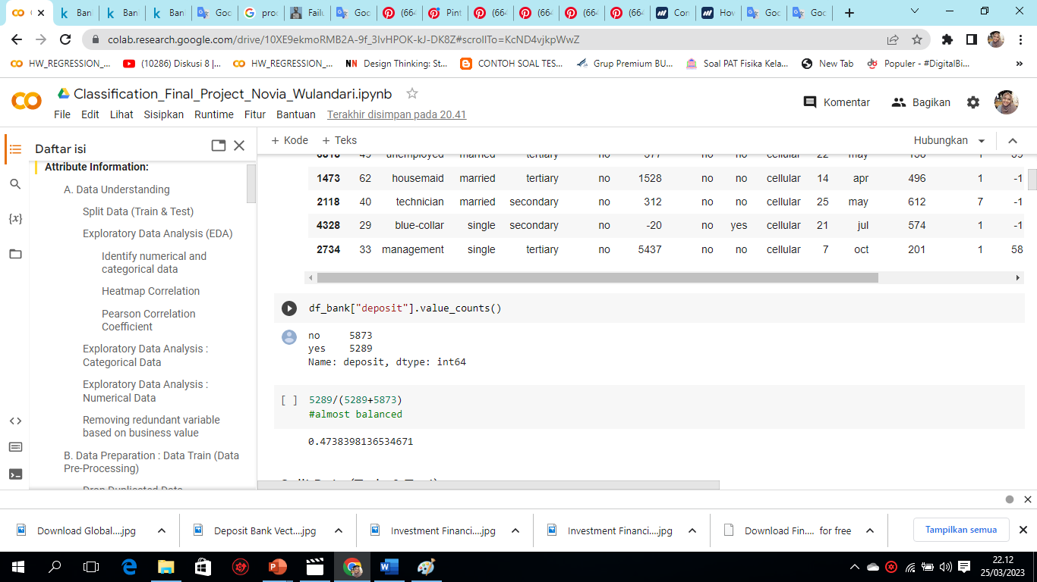
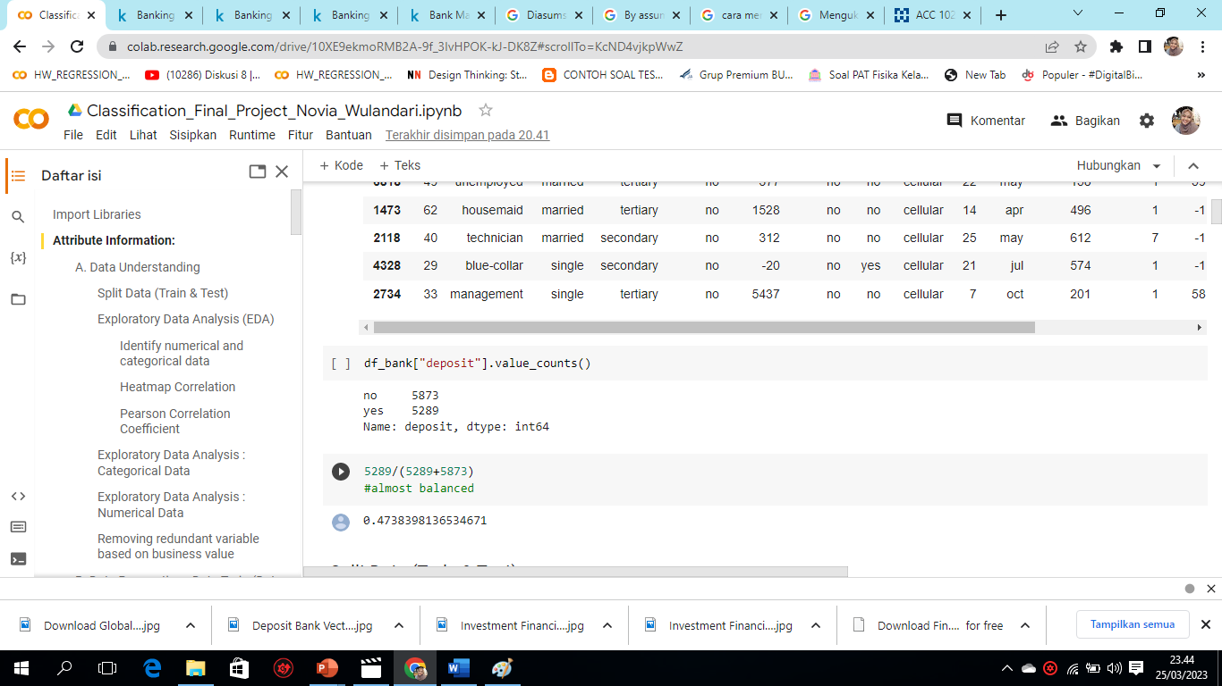
Calculate the number of customers who have term deposit
How to increase the Bank's income?
One way is to increase the number of customers who have term deposits
How do Bank increase the number of customers who have term deposits?
One of them in the bank's dataset.csv this is by direct marketing campaigns (phone calls) from banking institutions.
As a result, there are customers who answer "yes" 5289, while "no" 5873. If calculated the percentage becomes 47% for "yes" and 53% for "no", it is almost balanced
Dataset Information
11162 rows
17 columns
Target: Deposit
Purpose:
Determine the best Machine Learning Model to predict whether customers will deposit terms or not
Yes
47%
No
53%

Slide 6
Dataset Information
Header | Definition
Age | Age of customer
Job | Job of customer
Marital | Martial status of customer
Education | Customer education level
Default | Has credit in default?
Housing | If costumer has housing loan
Loan | Has Personal Loan
Balance | Customer's individual balance
Header | Definition
Contact | Communication type
Month | Last contact month of year
Day | Last contact day of the week
Duration | Last contact duration, in seconds
Campaign | Number of contacts performed during this campaign and for this client
Pdays | Number of days that passed by after the client was last contacted from a previous campaign
Previous | Number of contacts performed before this campaign and for this client
Poutcome | Outcome of the previous marketing campaign
Deposit | Has the client subscribed a term deposit
Jupiter is a gas giant and the biggest planet in the Solar System. It's the fourth-brightest object in the night sky. It was named after a Roman god

Slide 7
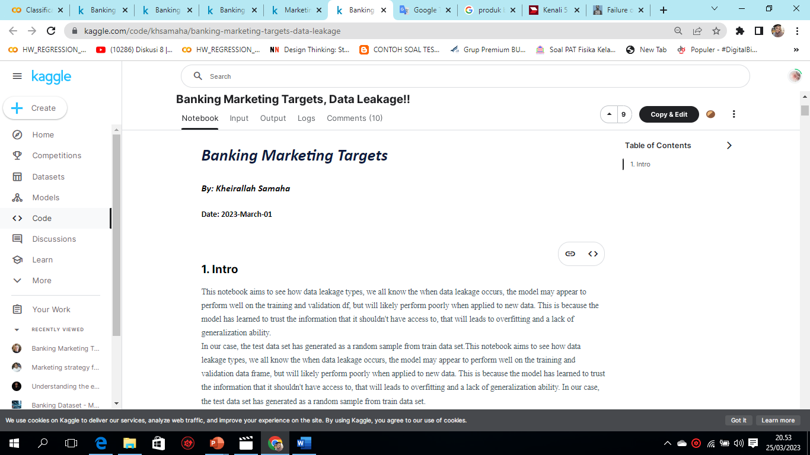
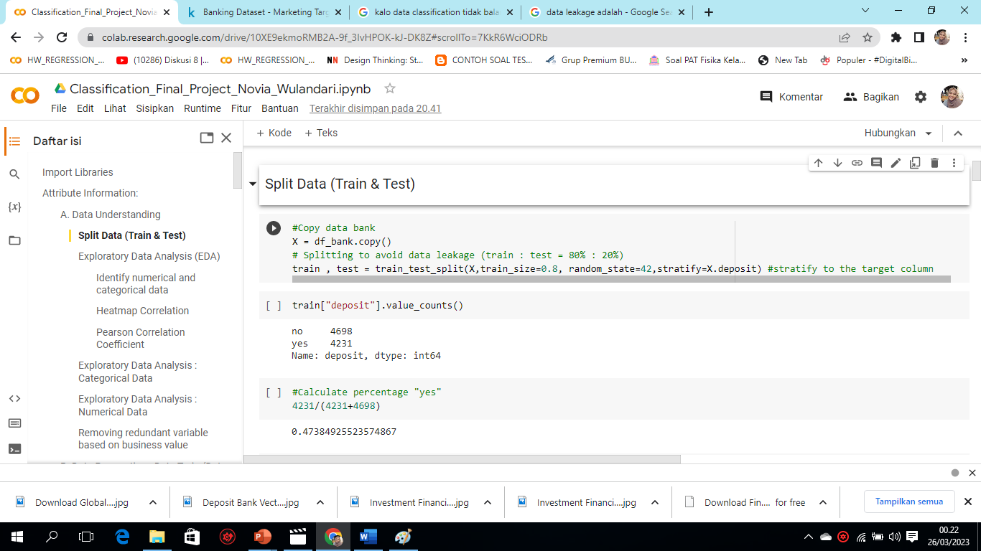
2. Split Train & Test data
Data split is done at the beginning, the goal is to avoid data leakage.
Train Data: 80%
Test Data: 20%
Premium
You can explain your product or your service
This underlies split train data decision making and test data is carried out at the beginning.
11162 baris
17 kolom
Target: Deposit
Source: https://www.kaggle.com/code/khsamaha/banking-marketing-targets-data-leakage

Slide 8
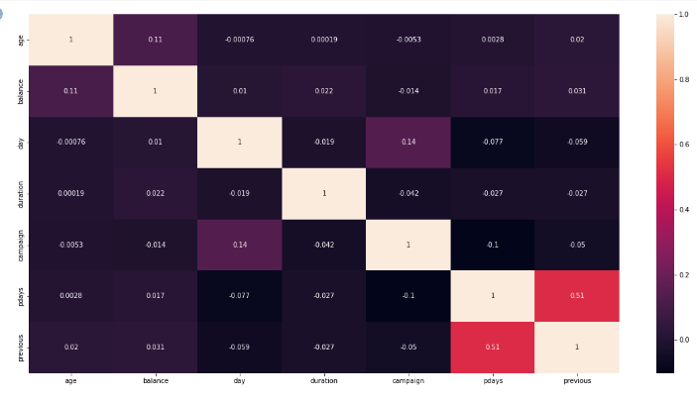
3. Exploratory Data Analysis (EDA)
1. Check numerical and categorical data identity
2. Heatmap Correlation
Categorical Data: job, marital, education, default, housing, loan, contact, month, poutcome.
Numrical data: Age, balance, day, duration, campaign, pdays
From the chart above, there doesn't seem to be any high correlation as most of the values are below 0.5. So, it is good practice to check it before selecting the variables into the regression model since is one of the steps to avoid overfitting. Correlation matrix: (0<=|c|<0.3: weak), (0.3<=|c|<0.7: moderate) & (0.7<=|c|<1: strong). In classification it's must not.

Slide 9
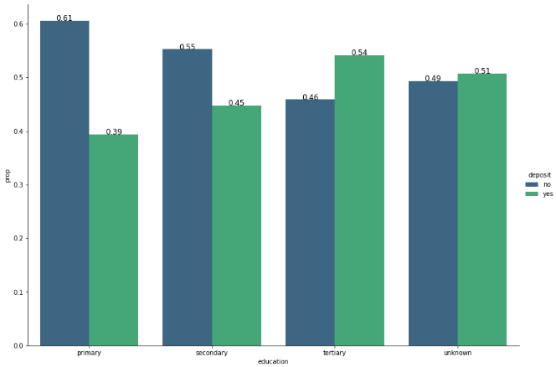
a. EDA: Categorical Data
Deposit Amount “Yes” & “”No
Calculate the number of customer deposits that are "yes" and "no" in each column using a proportion value. For example, for the category "Education"
Categorical Data | Highest "Yes" category | Highest "No" category
Education | Tertiary | Primary
Job | Student | Blue-Collar
Marital | Single | Married
Default | no | yes
Housing | no | yes
Loan | no | yes
contact | celullar | unknown
Month | december | May
Poutcome | success | unknown
Conclusion: there are values in the category column that do not make sense such as "yes" the highest deposit term in the "student" category. But still some of the other category columns make sense.

Slide 10
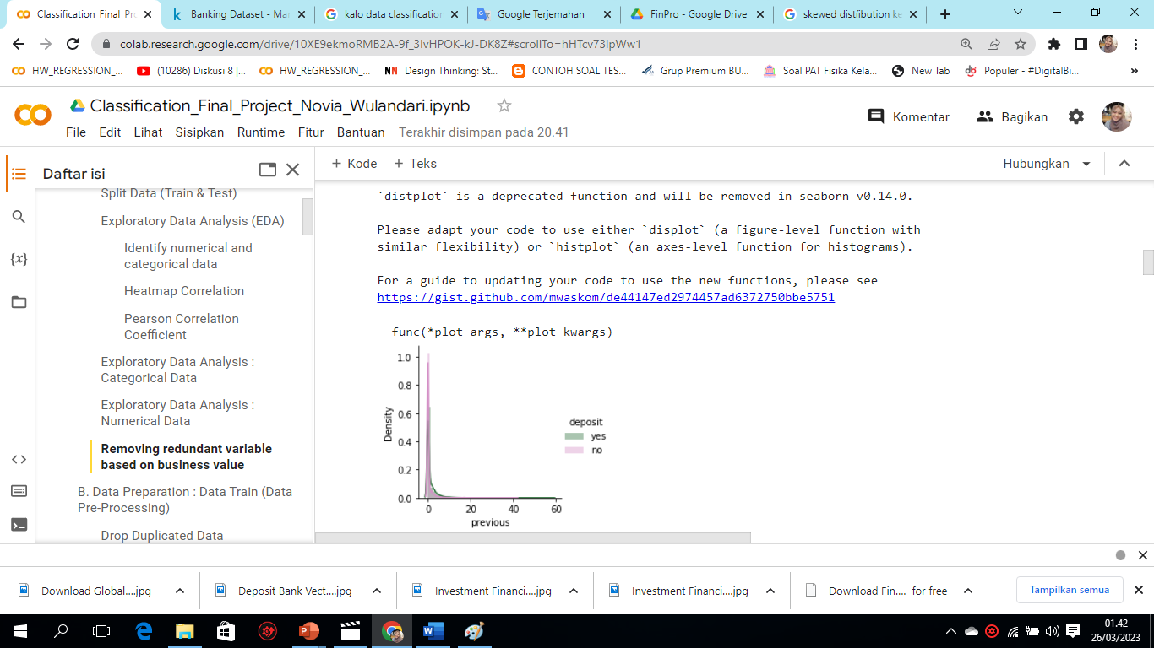
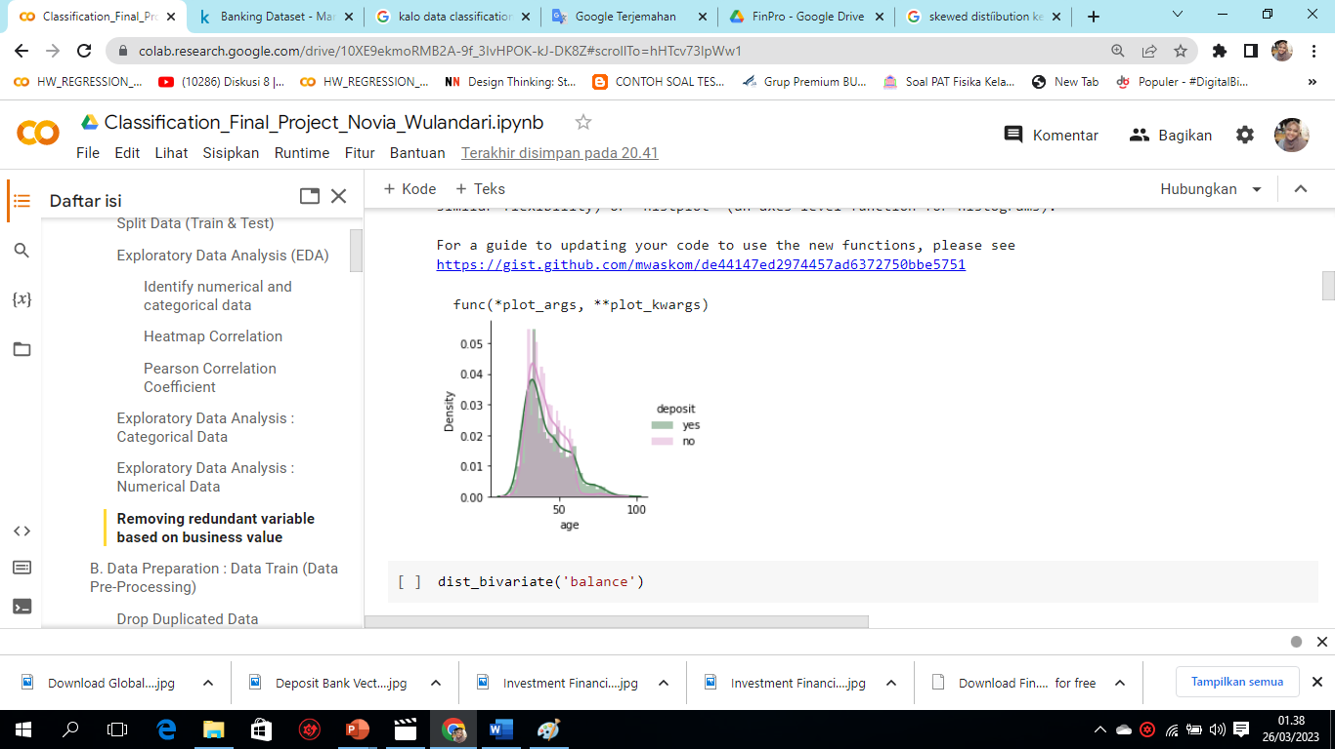
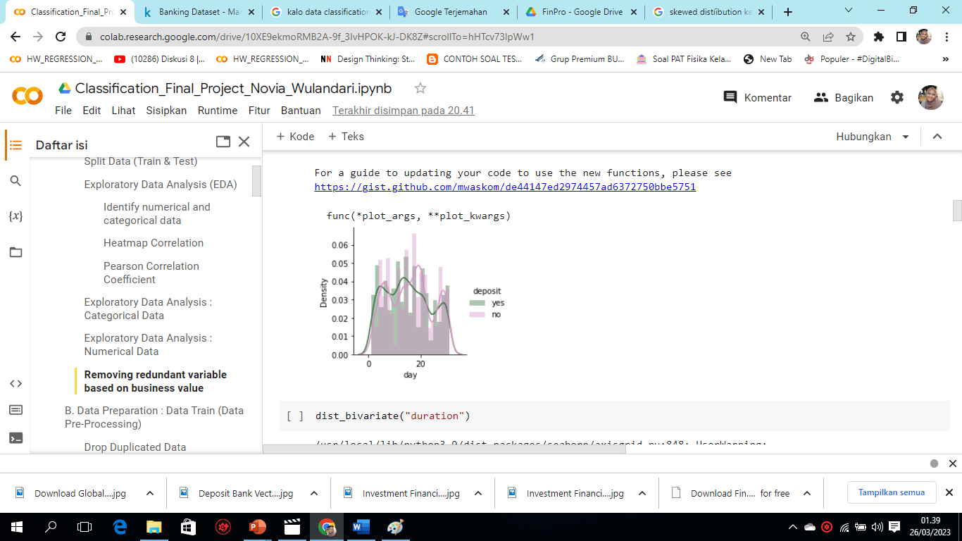
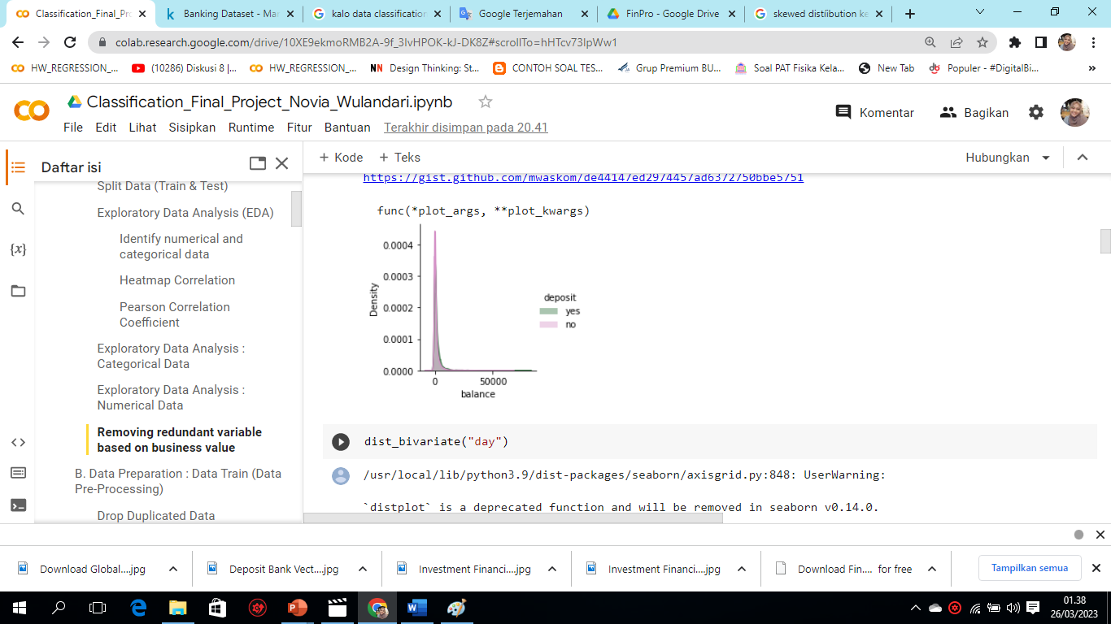
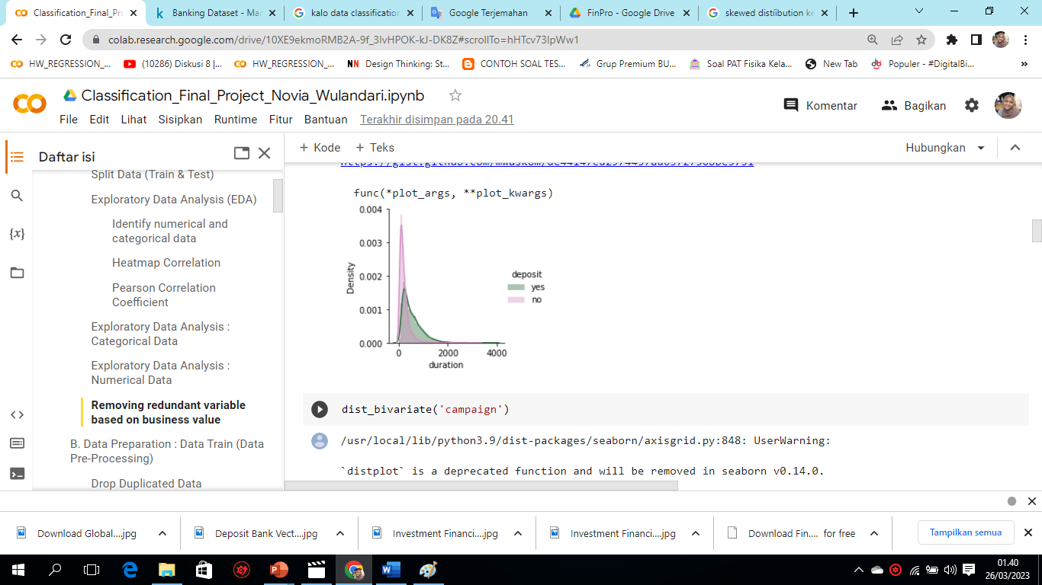
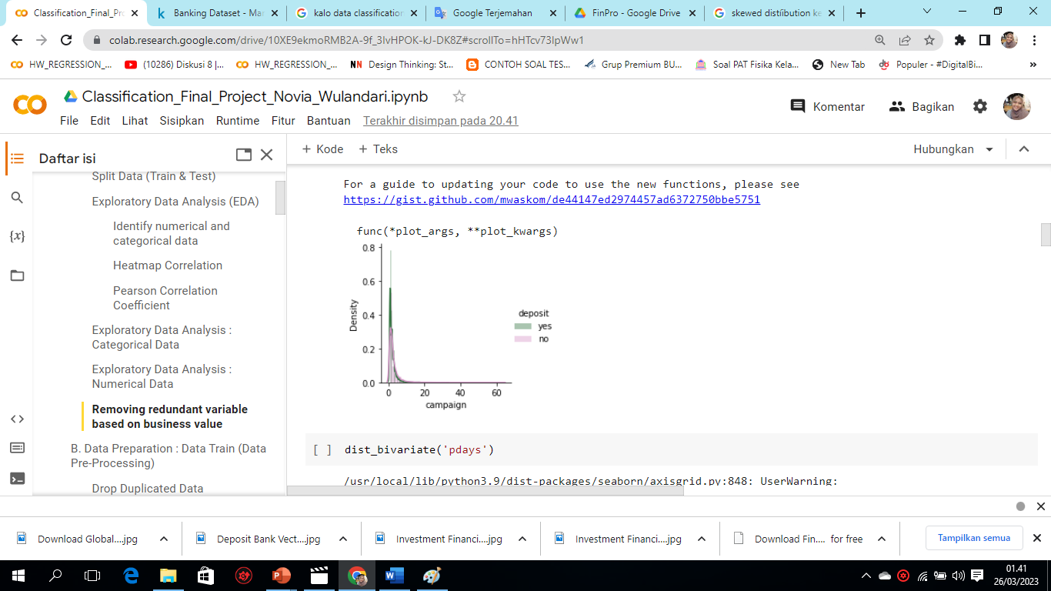
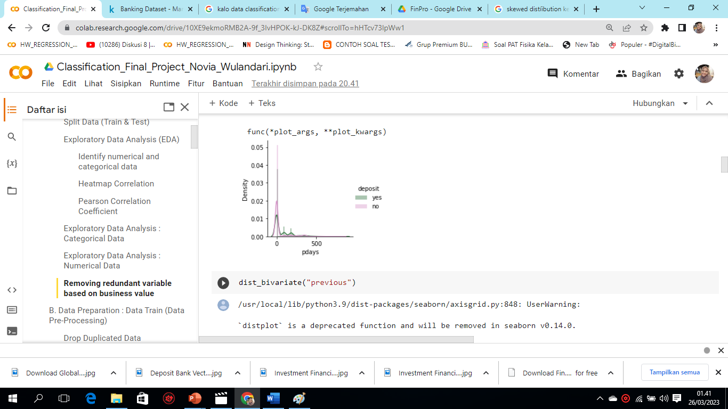
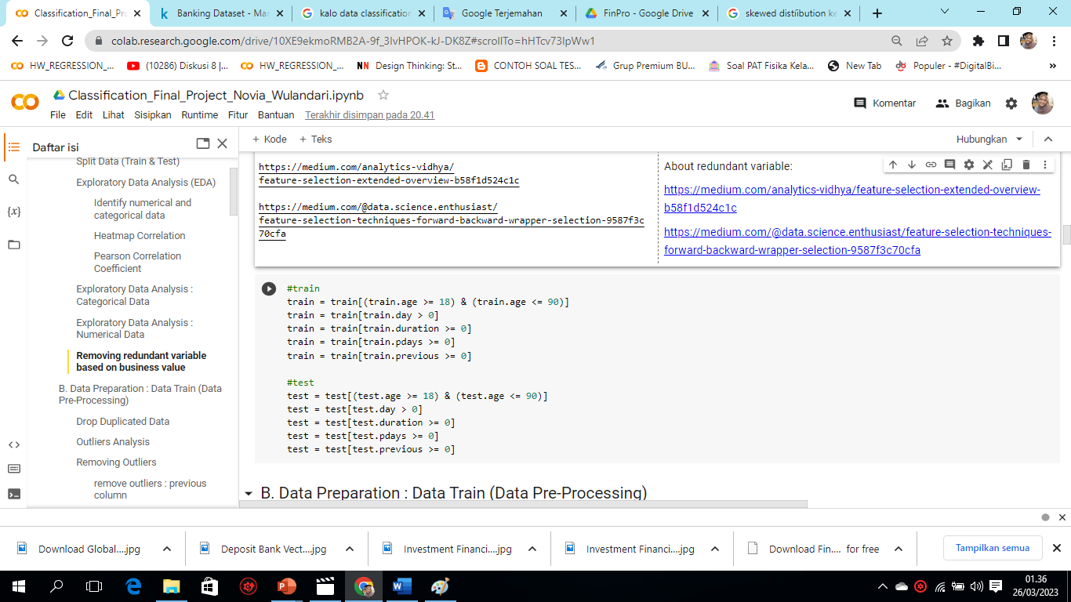
b. EDA: Numerical Data
EDA results Numerical data is :
95 years old is the highest age, 95 years old is less reasonable/very rare, based on business value this is a redundant variable.
Max and min values make sense in all columns
None of the columns have symmetric distribution.
All columns have skewed right/positive distribution
There are no negatively/left skewed columns
Conclusion: removing redundant variables based on business value in the age, day, duration, pdays, previous columns.
Referensi bussiness value: https://finansial.bisnis.com/read/20220730/90/1561069/bca-bbca-catat-ada-48000-nasabah-aktif-gunakan-layanan-sms-banking

Slide 11
B. Data Preparation: Train Data & Test Data

Slide 12
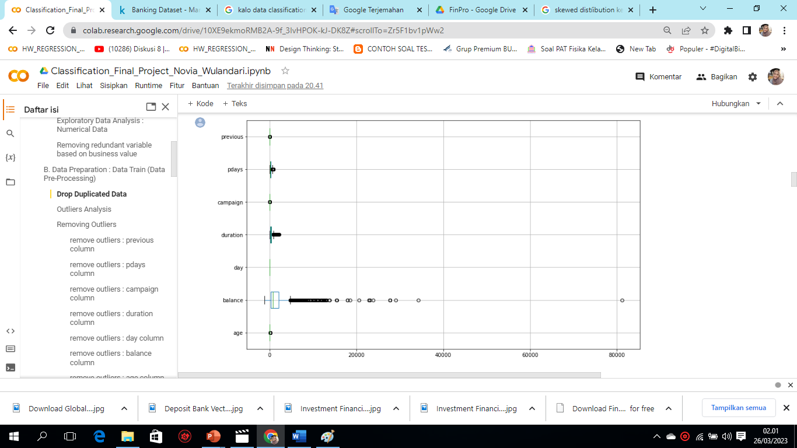
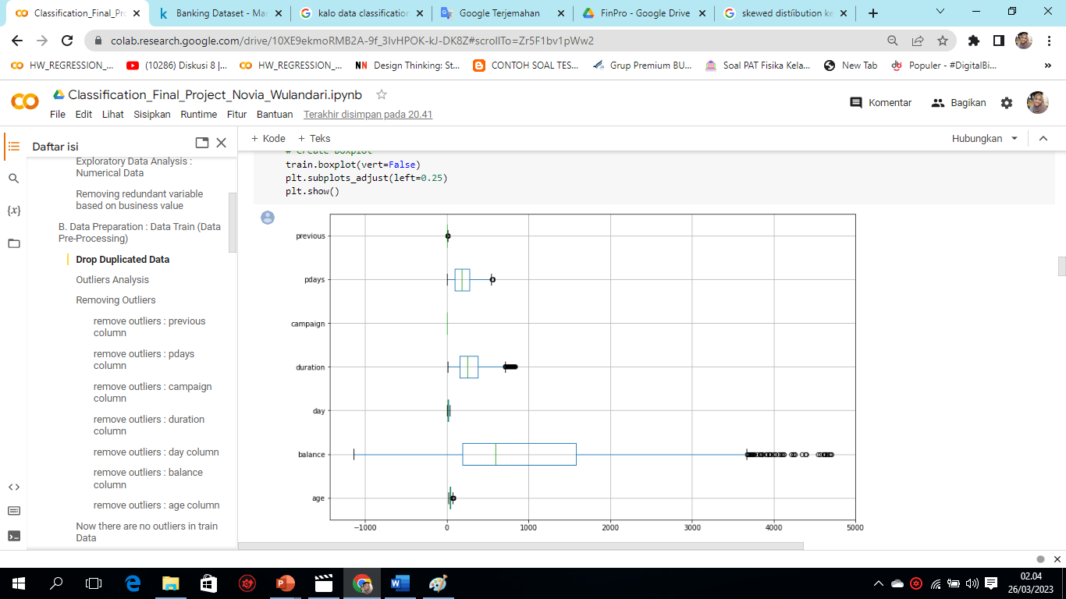
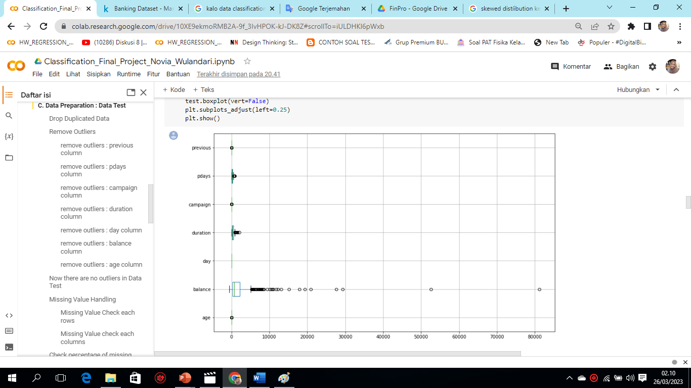
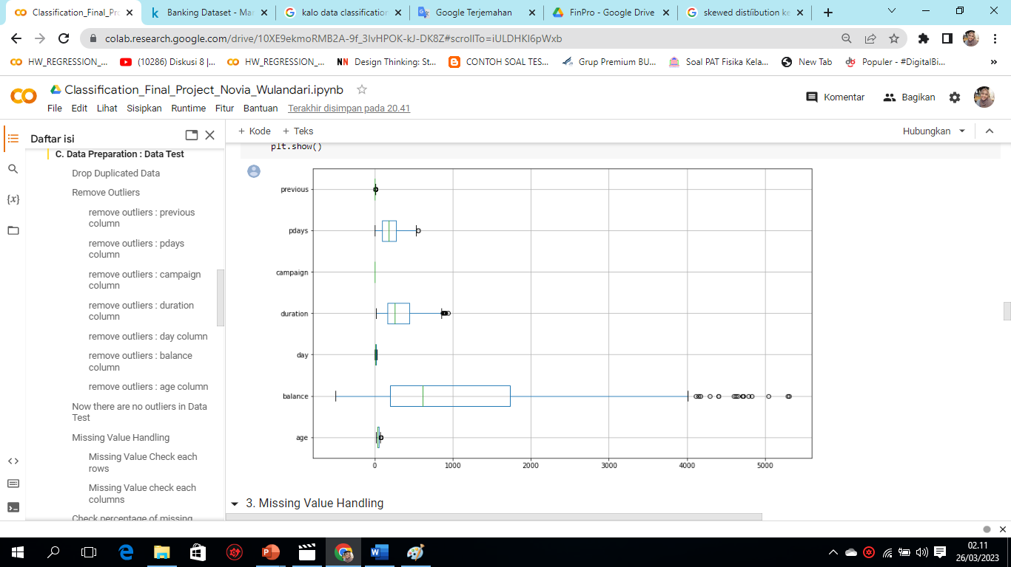
The results of the Data Preparation steps: Train & Test
Steps of DP | Train Data | Test Data
1. Duplicated data | No duplication | No duplication
2. Outliers Analysis | There are outliers & remove outliers per column using IQR | There are outliers & remove outliers per column using IQR
3. Missing Value | Yes "unknown" in job, education, contact fields | Yes "unknown" in job, education, contact fields
Outliers Train Data before removing
Outliers Train Data after removing
Outliers Test Data before removing
Outliers Test Data after removing

Slide 13
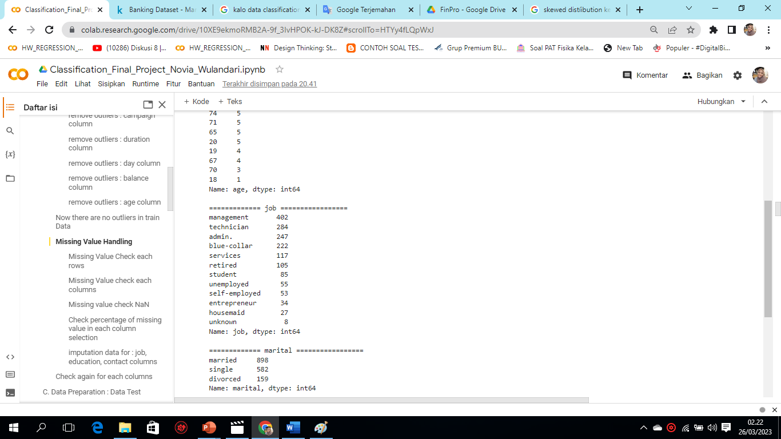
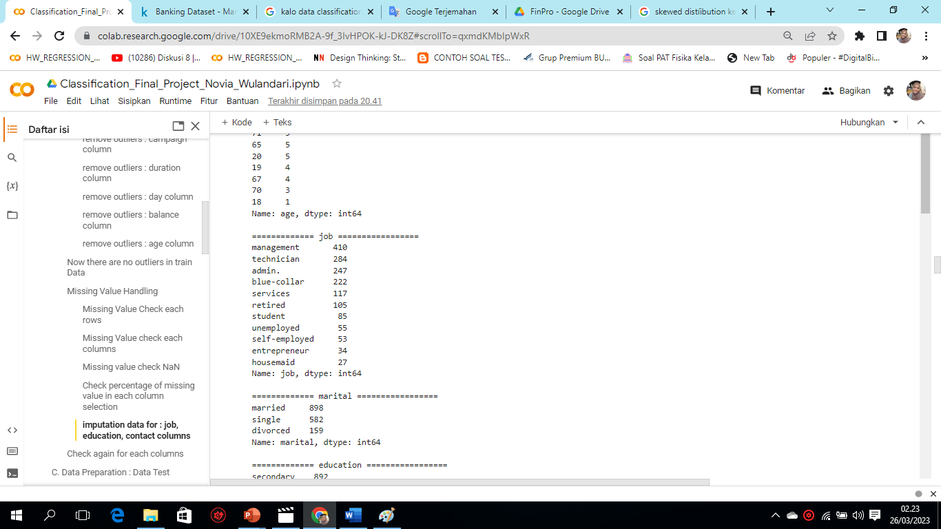
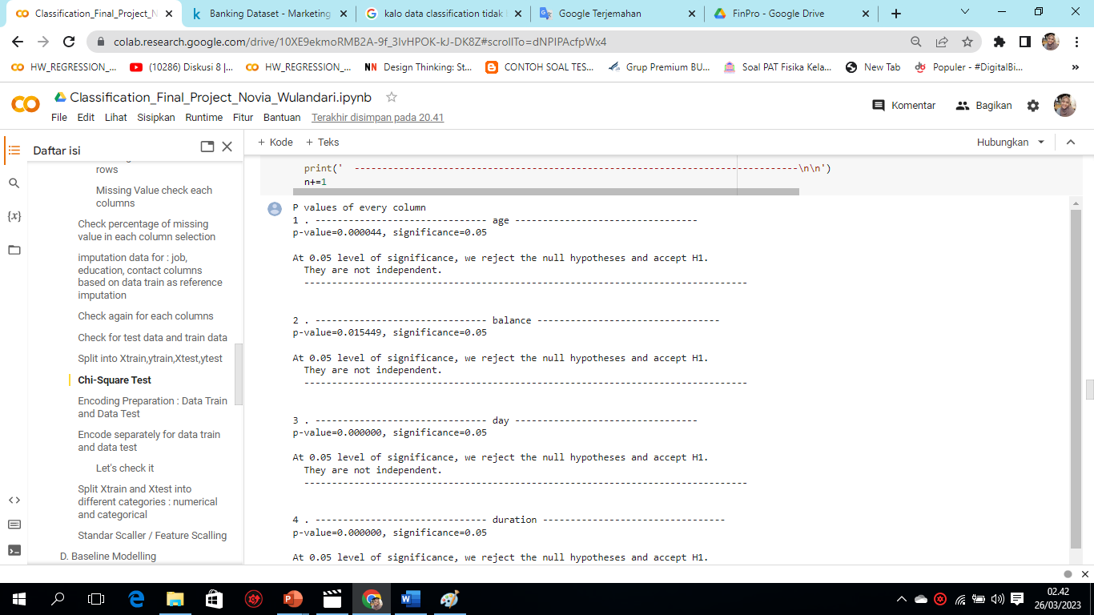
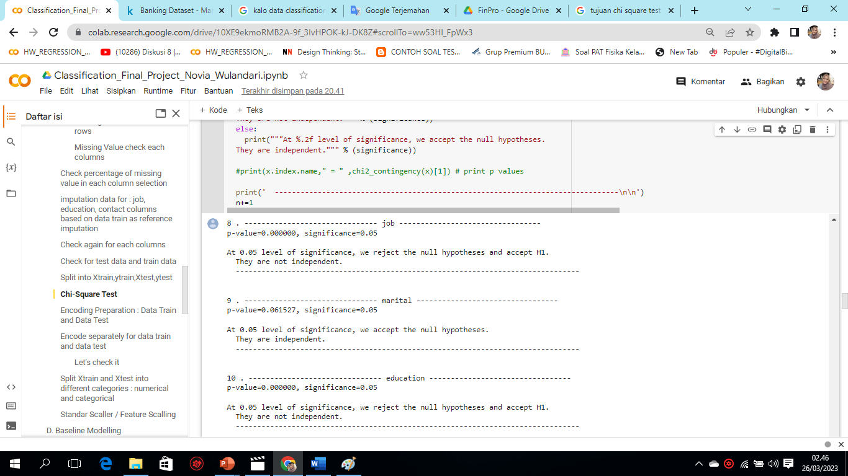
The results of the Data Preparation steps: Train & Test
Steps of DP | Train Data | Test Data
4. Data Imputation | Replace "unknown" in each column with the mode according to the category | Replace "unknown" in each column with the mode according to the category
5. Split into Xtrain,ytrain,Xtest,ytest
6. Chi-Square Test on categorical data and numerical data | Only performed on train data as a representative because the purpose of chi-square is to investigate the dependency between x and y categories. Most of the results are "not independent". As long as there is a column where the result is "not independent", it means that there is no relationship between the predictor variables. |  | -
For one example shown in the job column before data imputation on the train data
For one example shown in the job column after data imputation on the train data
Chi-Square Test on numerical data
Chi-Square Test on categorical data

Slide 14
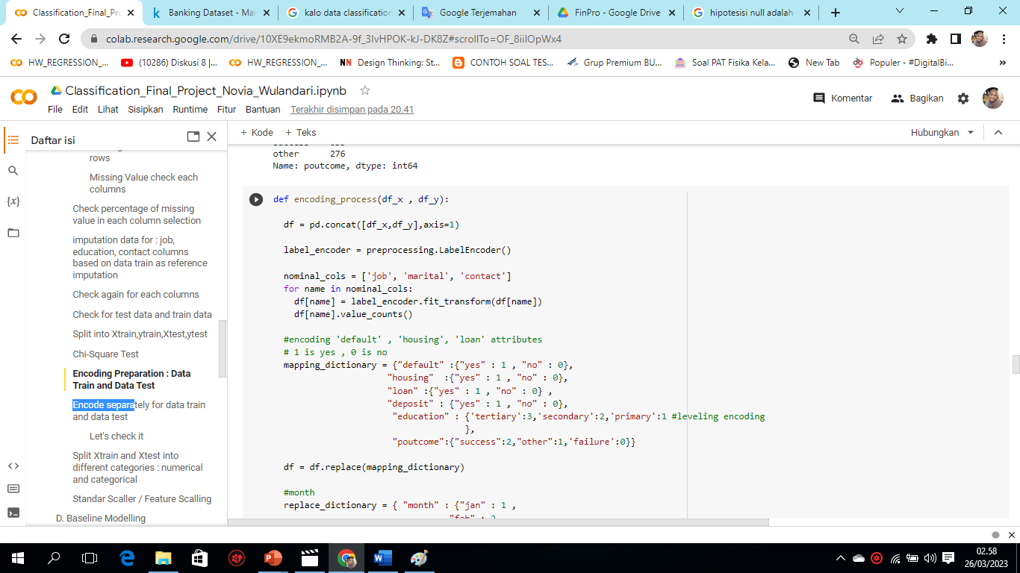
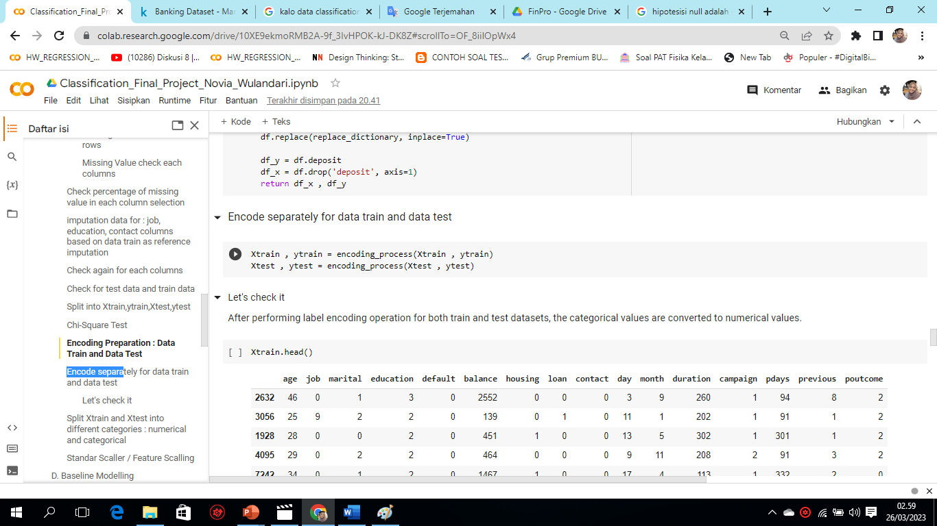
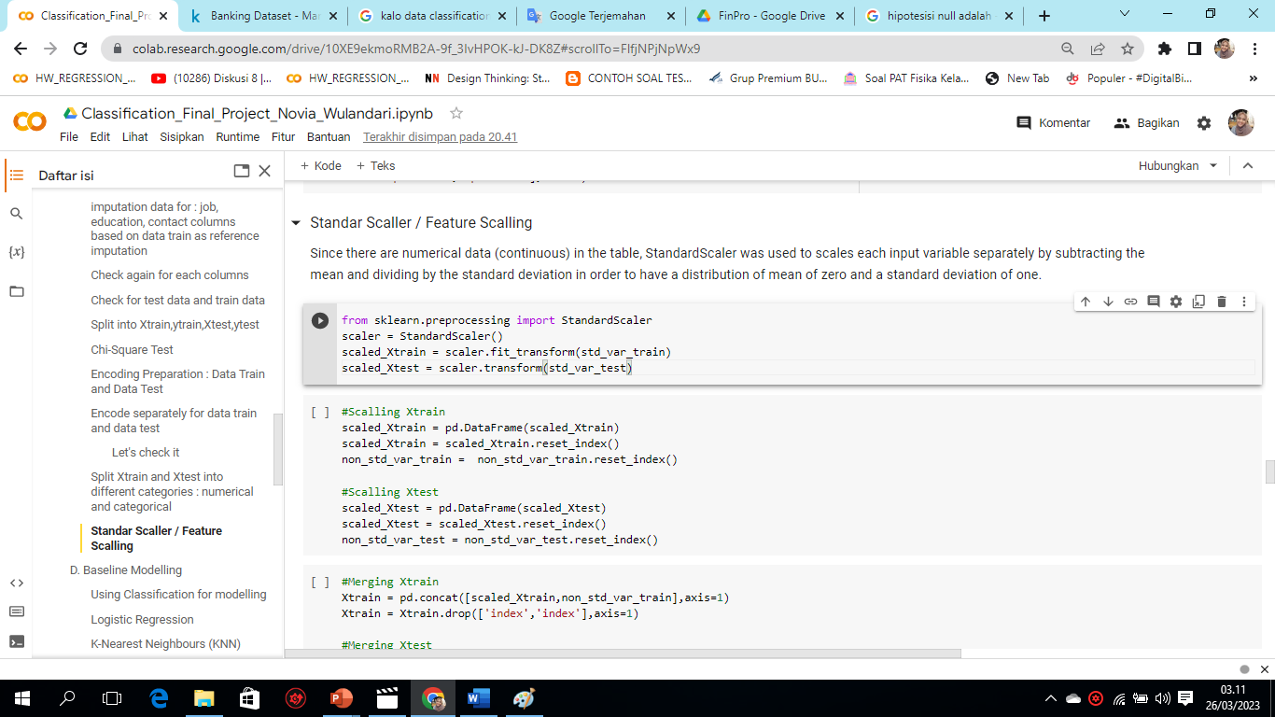
The results of the Data Preparation steps: Train & Test
Steps of DP | Train Data | Test Data
7. Encoding Preparation | Label Encoder one-hot encoding is performed on non-leveled categorical data: job, marital, contact, while for leveling using dictonary mapping. | Label Encoder one-hot encoding is performed on non-leveled categorical data: job, marital, contact, while for leveling using dictonary mapping.
8. Split Xtrain and Xtest into number & categorical
9. Standar Scaller | Since there are numerical (continuous) data in the table (balance, duration, pdays columns), StandardScaler is used to scale each input variable separately by subtracting the mean and dividing it by the standard deviation to get a distribution of mean zero and standard deviation one.
Encoding Process
Standard Scaller Process

Slide 15
C. Modelling Machine Learning

Slide 16
Baseline Machine Learnig | Test Accuracy | Train Accuracy | Selesih Accuracy (<15%, normal) | Hasil
1. Logistic Regression | 79.25 % | 82.24% | 2..99% | Normal
2. K-Nearest Neighbours (KNN) | 67.75 % | 83.47% | 15.72% | Overfit
3. Naïve Bayes | 76.25 % | 79.87% | 3.62% | Normal
4. Support Vector Machine (SVM) | 74.0 % | 74.92% | 0.92% | Normal
5. Decision Tree | 76.0 % | 100.0 % | 24.0% | Overfit
6. Random Forest | 84.0 % | 100.0 % | 16.0% | Overfit
7. XGBoost | 84.0 % | 100.0 % | 16.0% | Overfit
Mars is a cold place, not hot. It’s full of iron oxide dust, which gives the planet its reddish cast
Conclusion:
The best baseline models are logistic regression, naïve bayes, and Support Vector Machine (SVM). Models with overfit results because models such as Decision Tree & Randome Forest are suitable for complex datasets (large number of columns and rows).

Slide 17
D. Evaluation & Tuning Model

Slide 18
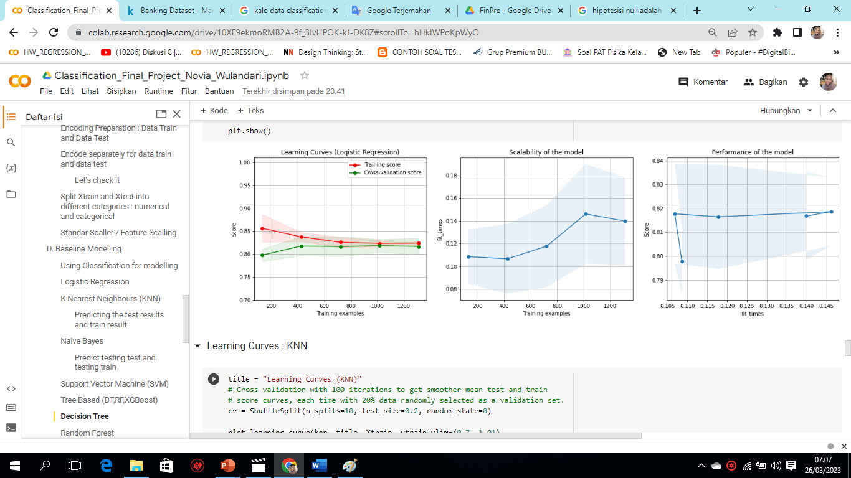
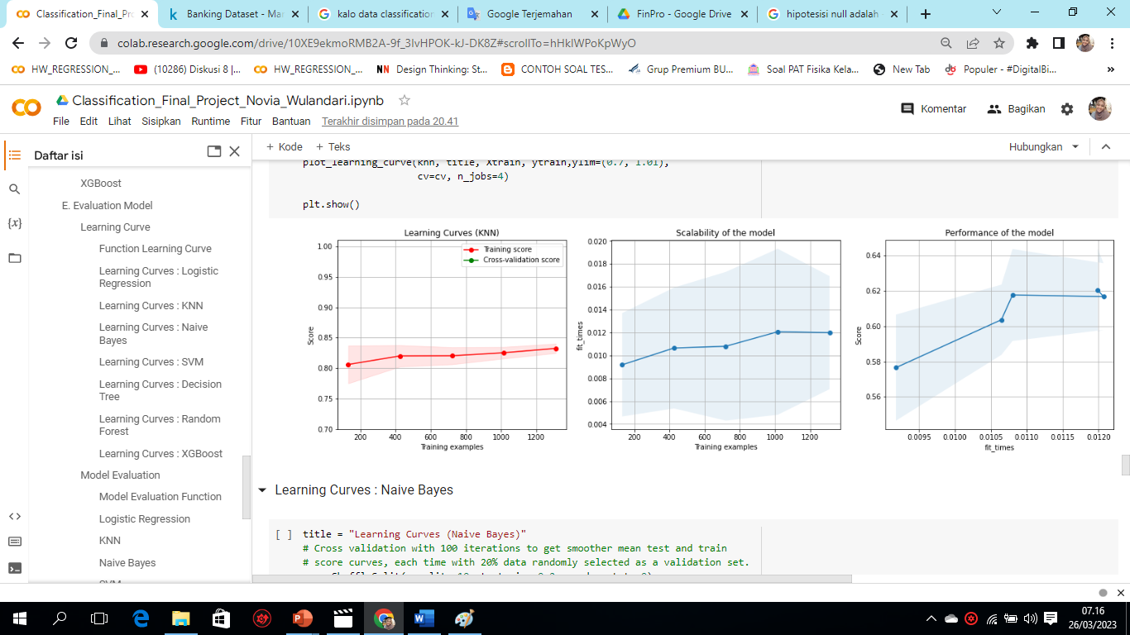
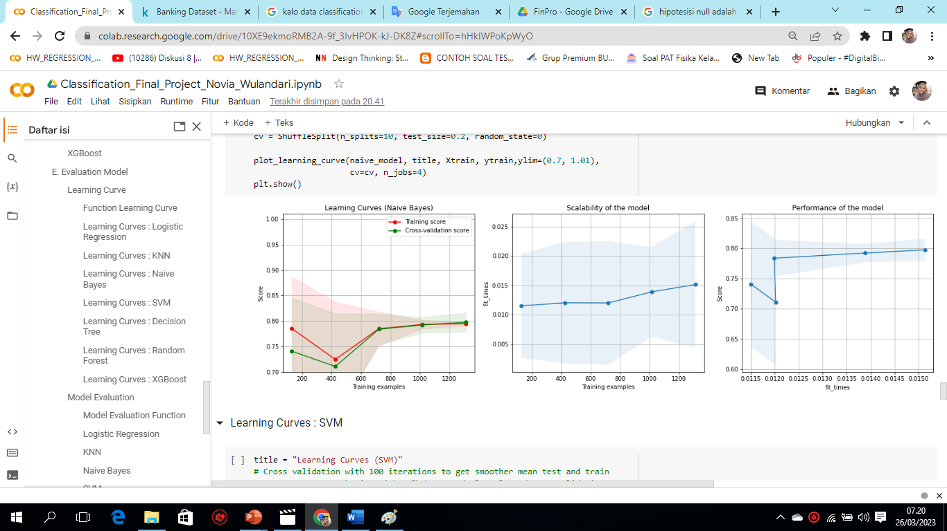
1. Learning Curve
Baseline Model
1. Logistic Regression
Normal (no overfit)
The trending is going up and up
Machine learning performance is getting better over time
2. KNN
Overfit
The trending is going up and up
Machine learning performance is getting better over time
3. Naive Bayes
Normal (no overfit)
The trending is going up and up
Machine learning performance is getting better over time

Slide 19
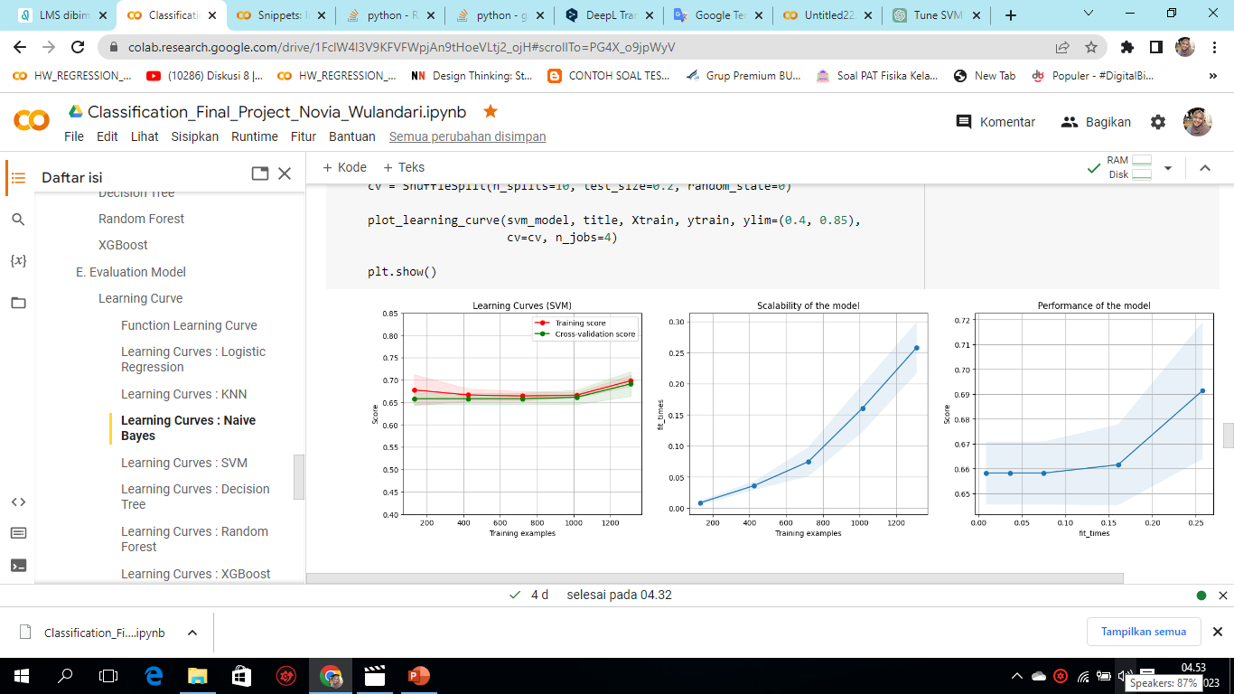
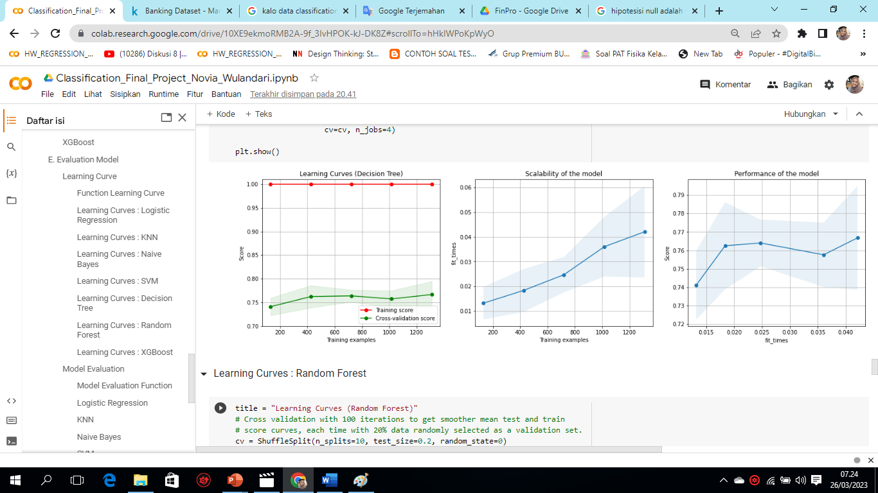
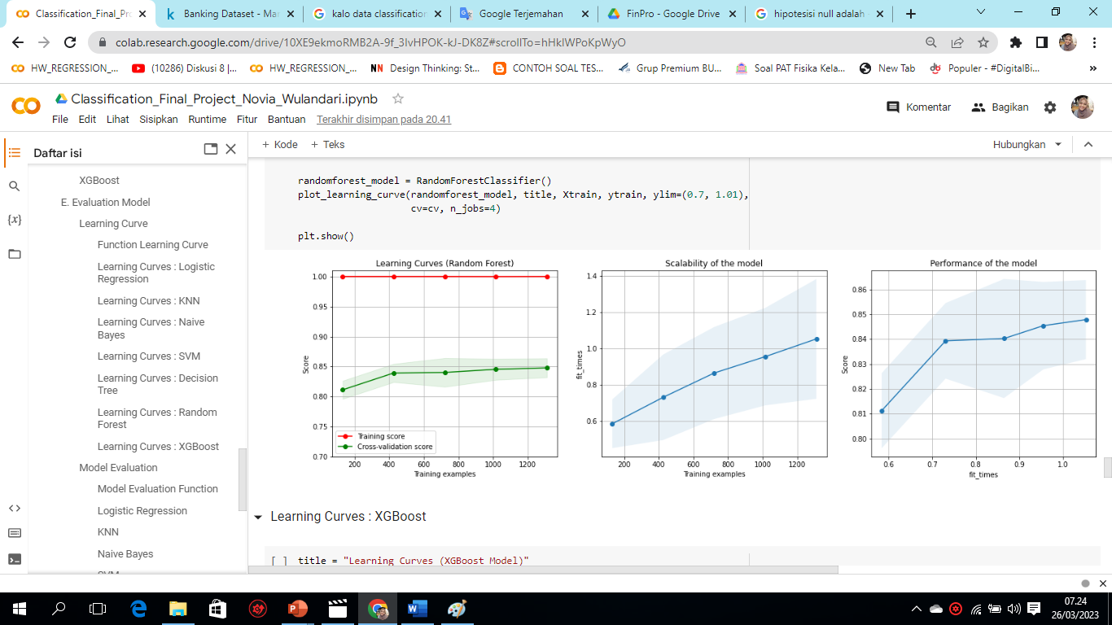
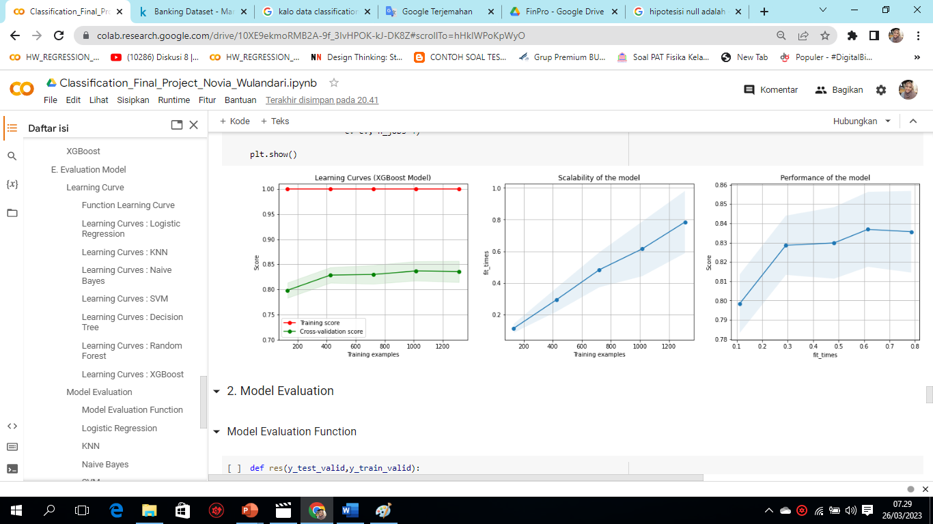
4. Support Vector Machine (SVM)
Normal (no overfit)
The trending is going up and up
Machine learning performance is getting better over time
5. Decision Tree
overfit
Machine learning performance is getting better over time
The trending is going up and up
6. Naive Bayes
overfit
The trending is going up and up
Machine learning performance is getting better over time
7. XGBoost
The trending is going up and up
Machine learning performance is getting better over time
overfit

Slide 20
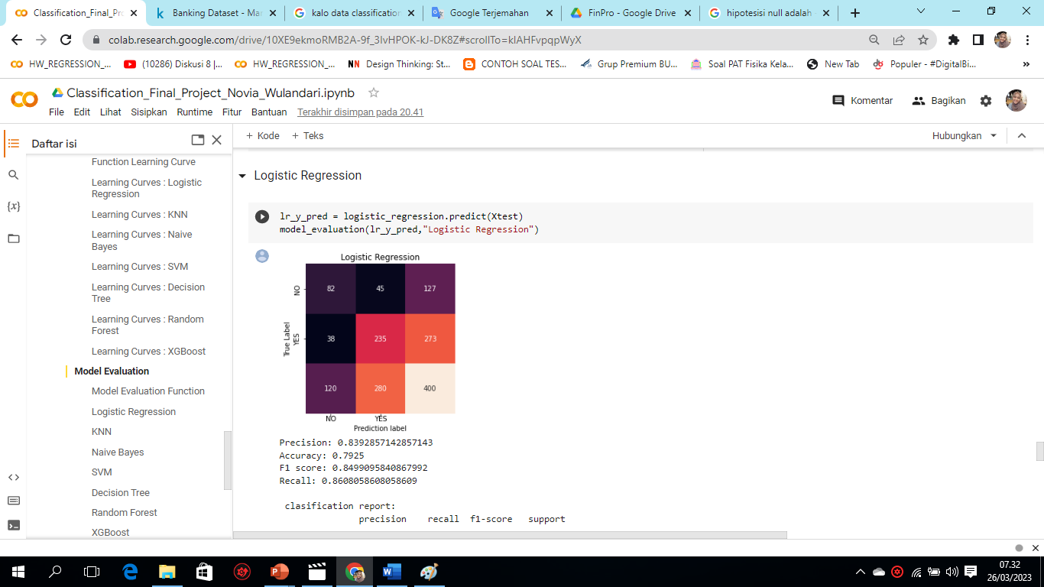
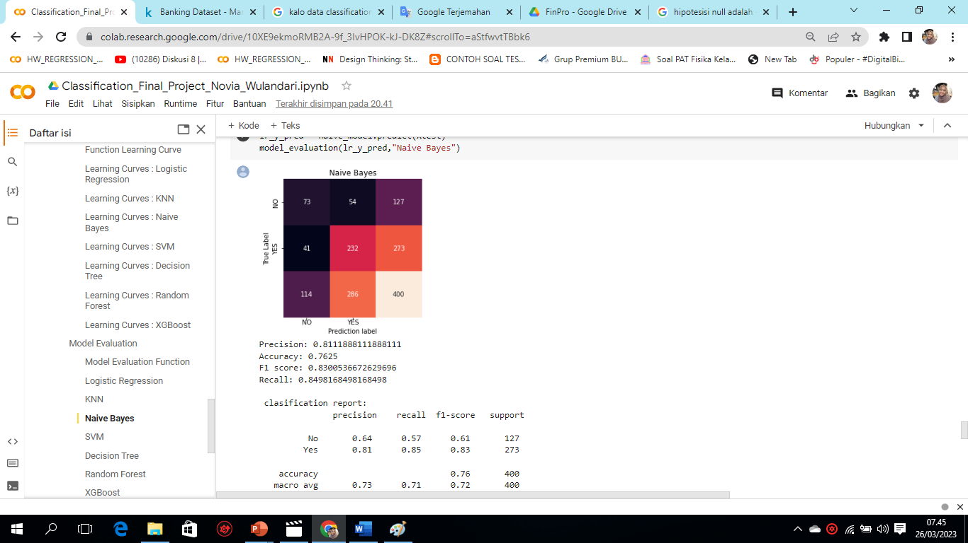
2. Model Evaluation
Conclusion:
From the model evaluation results with a fixed learning curve, the best baseline models are logistic regression, naïve bayes, and Support Vector Machine (SVM).
1. Logistic Regression
2. Naive Bayes
45 were predicted to deposit but did not actually deposit 38 were predicted not to deposit but actually did depositin
other words,
true positive/successfully predicted deposit = 235
true negative/successfully predicted no deposit = 82
false positives/deposits not successfully predicted = 38 false negative/unsuccessfully predicted no deposit = 45
54 were predicted to deposit but actually did not deposit as many as 41 were predicted not to deposit but actually did depositin
other words,
true positive/successfully predicted deposit = 232
true negative/successfully predicted no deposit = 73
false positives/deposits that were not successfully predicted = 41
false negative/unsuccessfully predicted no deposit = 54

Slide 21
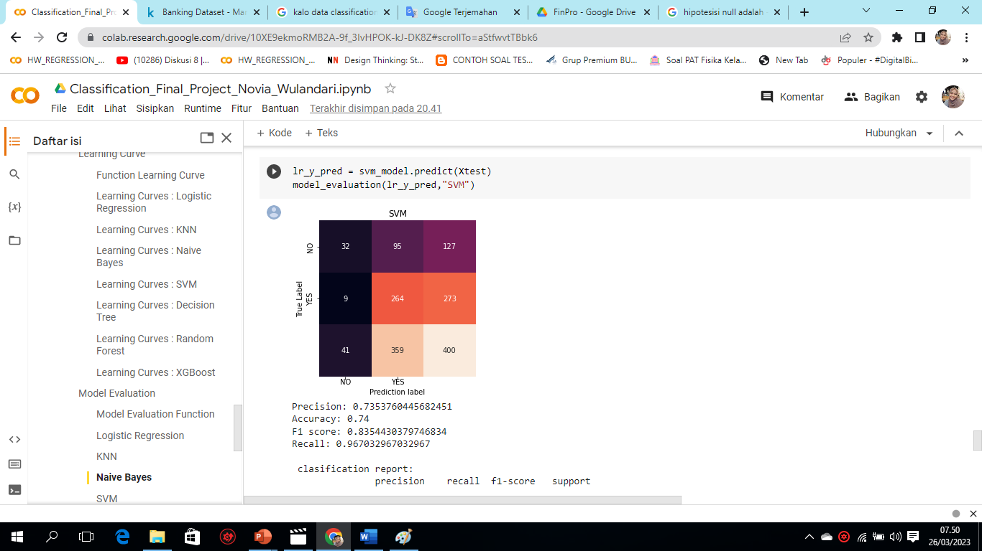
3. Hyperparamater Tuning
3. SVM
95 were predicted to deposit but did not actually deposit 9 were predicted not to deposit but actually did depositin
other words,
true positive/successfully predicted deposit = 264
true negative/successfully predicted no deposit = 32
false positives/deposits that were not successfully predicted = 9
false negative/not deposit that was not successfully predicted = 95
Hyperparameter tuning is done to avoid overfiting.
Hyperparameter tuning was performed on all three models with GridSearch and Random Search.

Slide 22
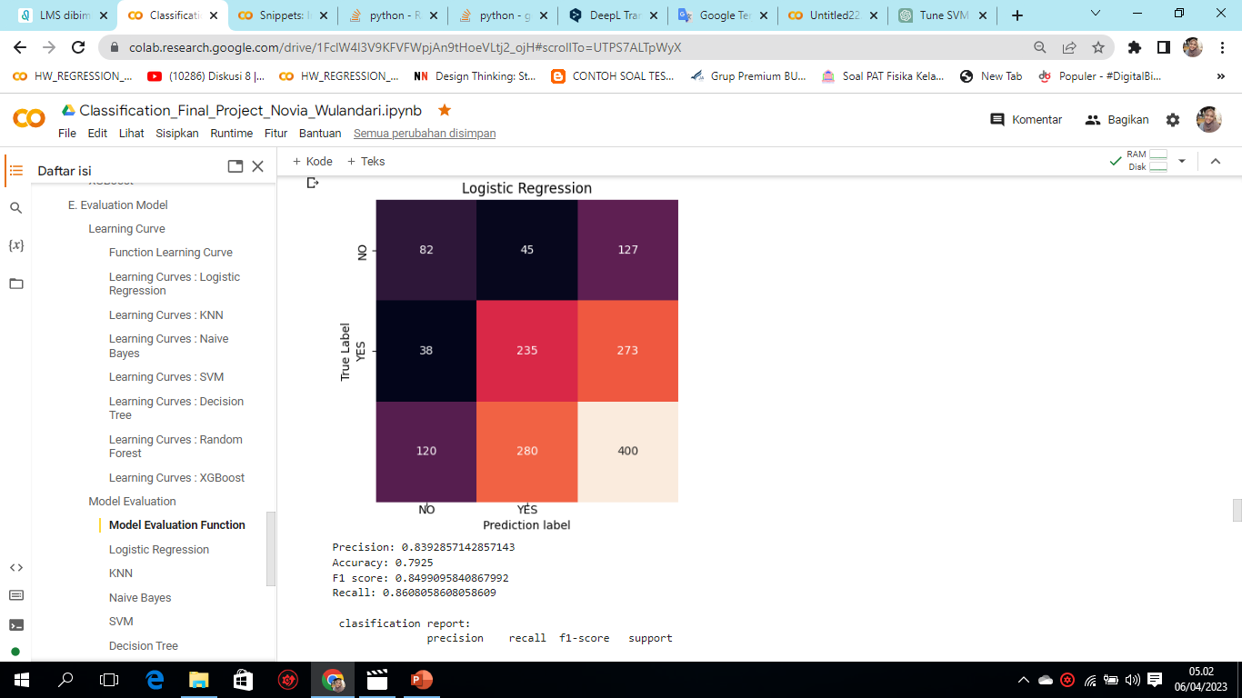
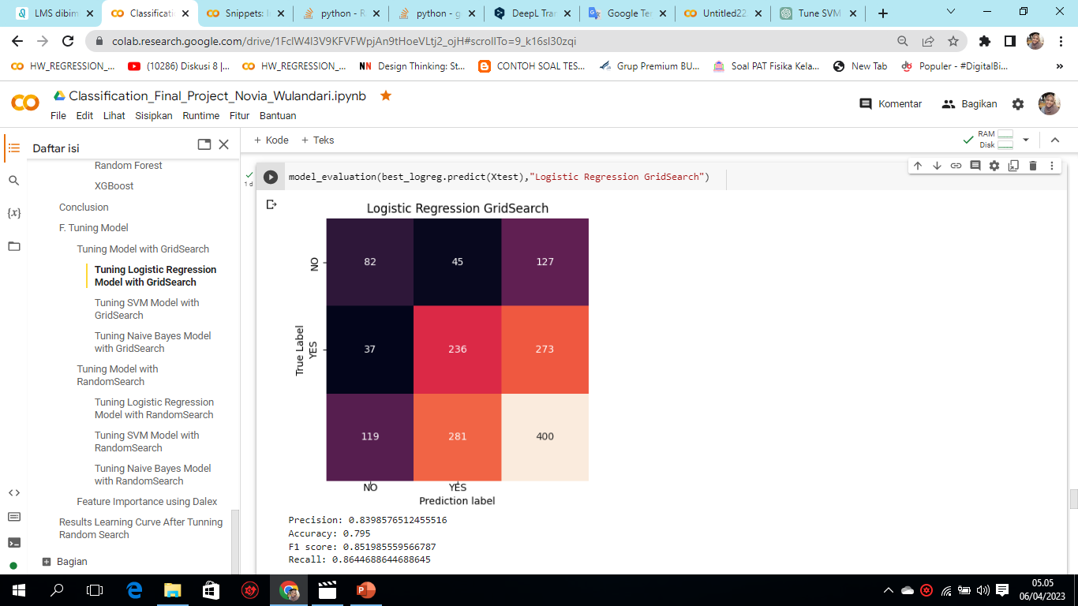
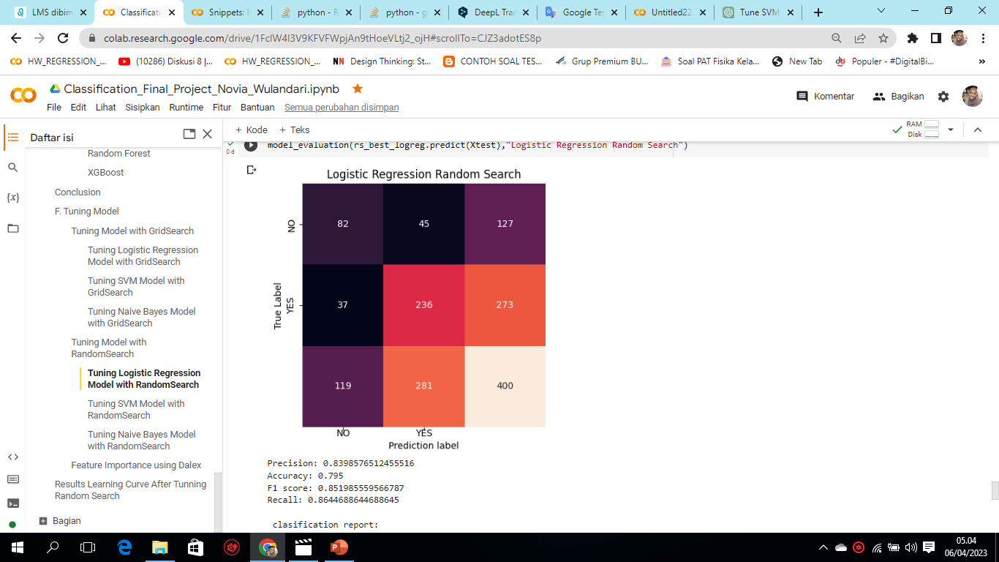
Results Model After Hyperparamater Tuning
1. Logistic Regression
The results of hyperparameter turning succeeded in increasing the term deposit, as seen from before hyperparameter turning for true positive/successfully predicted deposits was 235, after hyperparameter turning using either GridSearch or RandomSearch increased to 236, and reduced for unsuccessfully predicted values from 38 to 37.

Slide 23
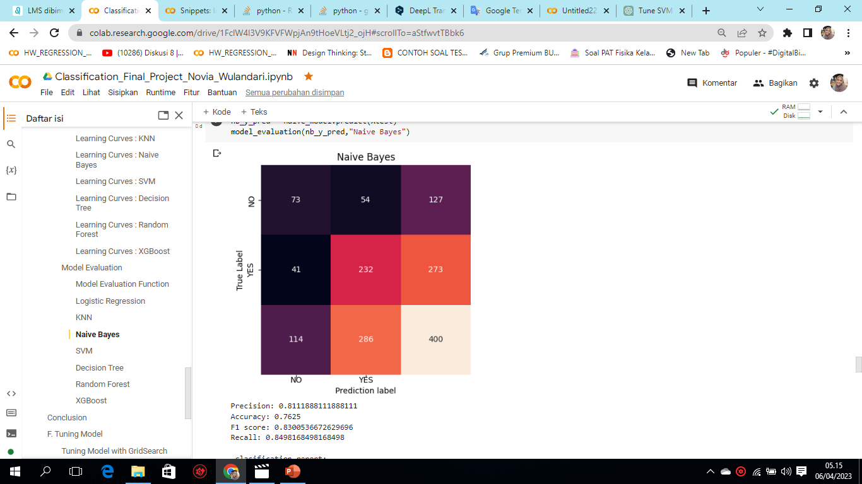
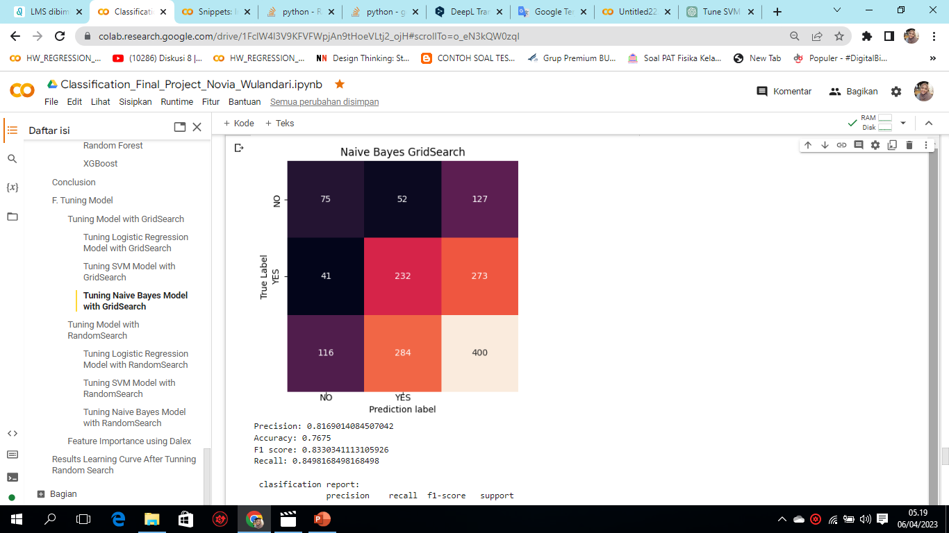
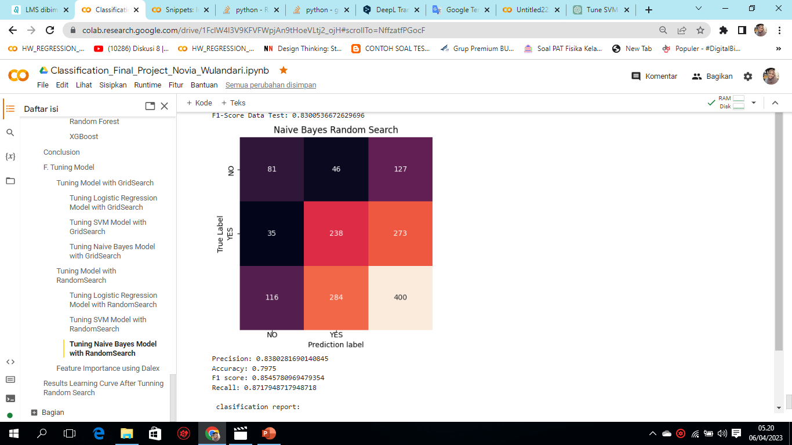
Results Model After Hyperparamater Tuning
2. Naive Bayes
The result of hyperparameter turning is successful to increase the term deposit, seen from before hyperparameter turning for true positive/successfully predicted deposit is 232, after hyperparameter tuning with RandomSearch has increased to 238, but with GridSearch the result is the same, which is still 232.

Slide 24
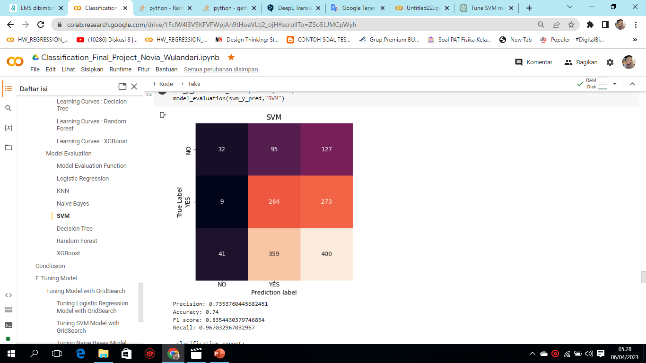
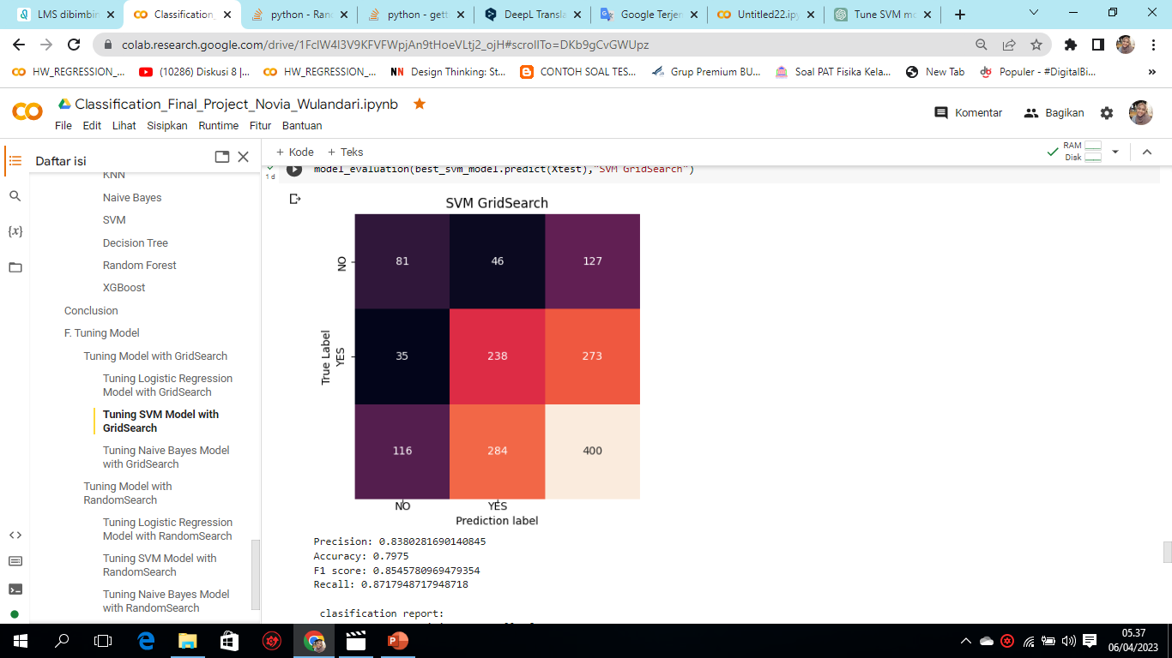

Results Model After Hyperparamater Tuning
3. SVM
The results of hyperparameter turning were not successful in increasing the term deposit, as seen from before hyperparameter tuning for true positive/successfully predicted deposit was 264, after hyperparameter tuning using either GridSearch or RandomSearch decreased to 232.

Slide 25
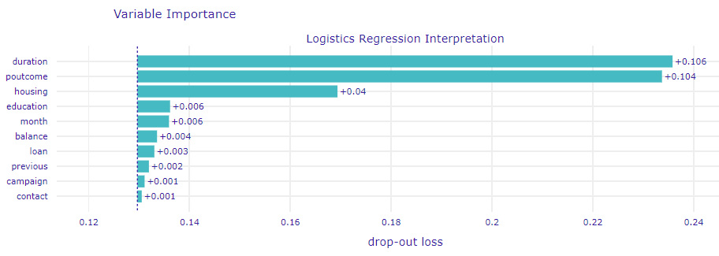
4. Feature Importance using Dalex
The results of feature importance using dalex is the most influential feature to make someone term deposit or not is first poutcome, then duration and housing. poutcome is the result of the previous marketing campaign, meaning that the thing to pay attention to here is to improve the marketing campaign. The second influential feature is duration, duration is the duration of the last contact in seconds. When doing a telephone campaign, the duration should not be too long and do not focus too much on customers who need a lot of calls because the possibility of becoming a depositor is reduced. The third feature is housing. Housing is a customer having a housing loan. Customers who have housing are less likely to term a deposit.

Slide 26
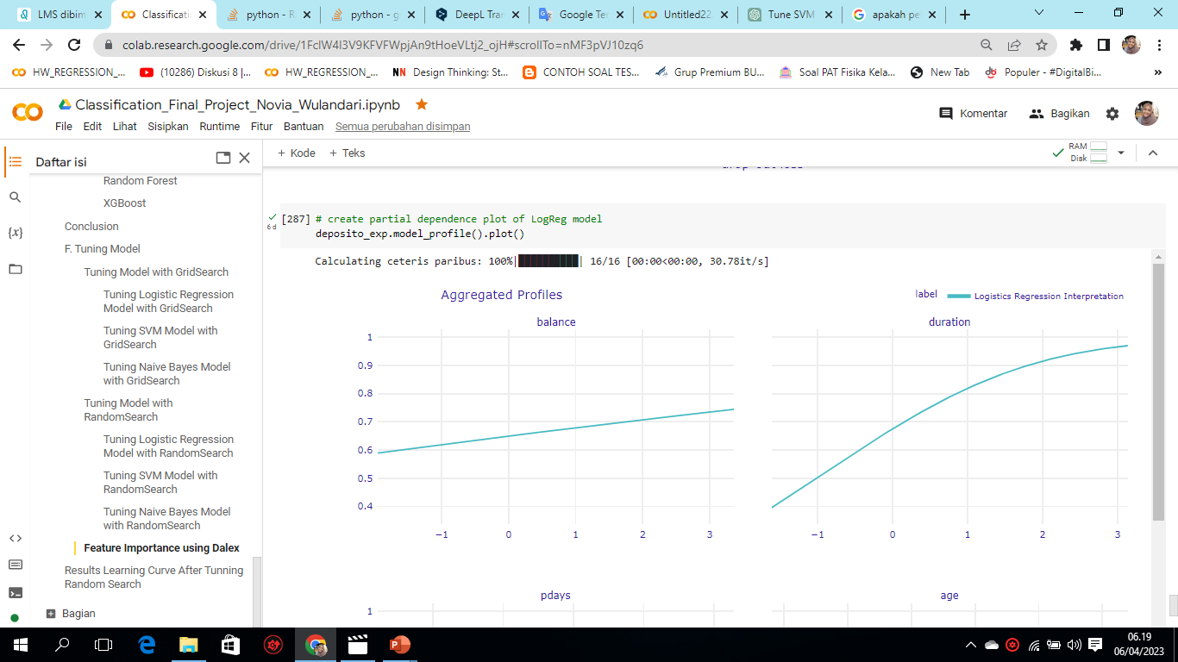
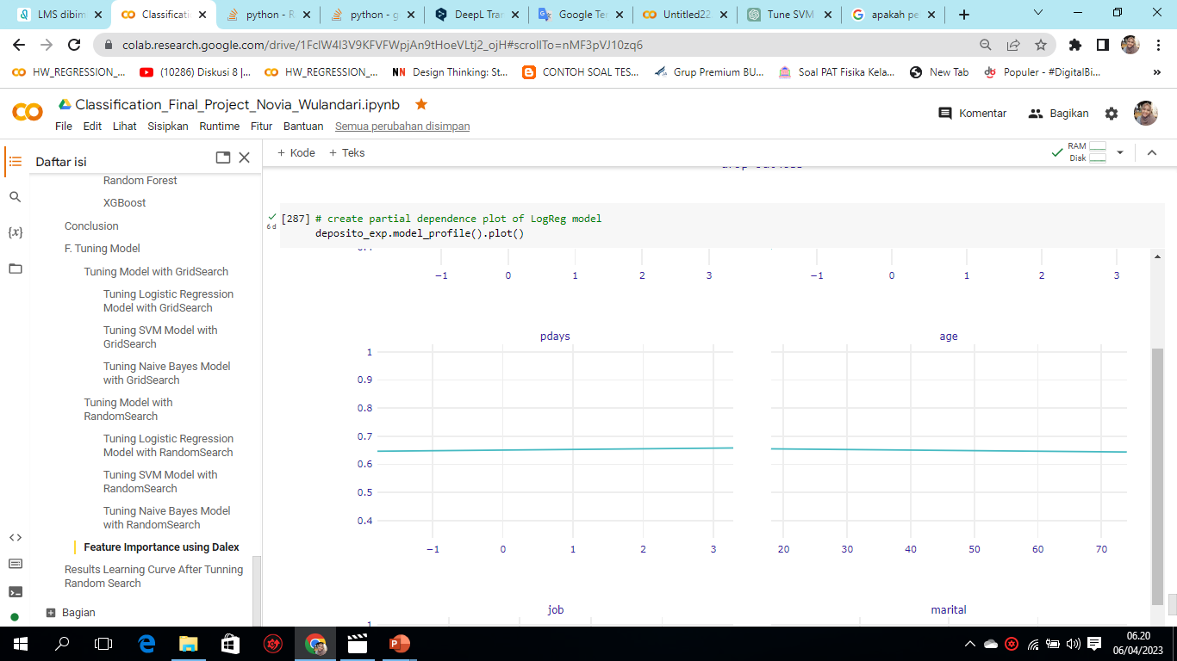
Partial dependence plot of LogReg model for each feature
In the balance feature, the curve is increasing, meaning that the potential for term desposit customers is getting higher.
In feature duration, the curve is increasing, meaning that the potential for term deposit customers is getting higher.
In the pdays and age featrues, the curve is straight tends to be constant, meaning that these two features do not really affect whether or not a customer makes a term deposit.

Slide 27
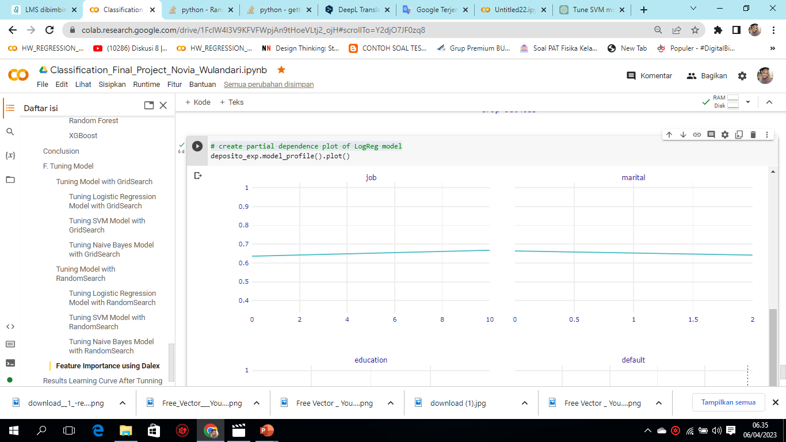
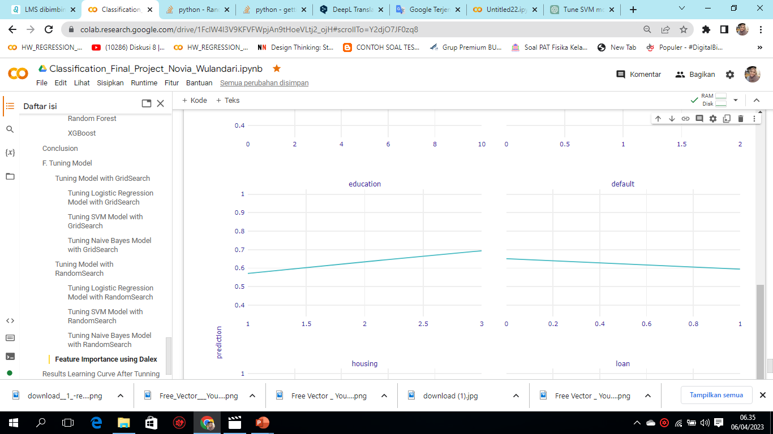
Partial dependence plot of LogReg model for each feature
In the job feature, the curve rises slightly, meaning that the potential for term desposit customers is getting higher.
In contact feature, the curve is marital, meaning that term deposit customers are decreasing.
In education feature, the curve is increasing, meaning that the potential for term desposit customers is getting higher.
In default the straight curve tends to be constant, meaning that feature do not really affect whether or not a customer makes a term deposit.

Slide 28
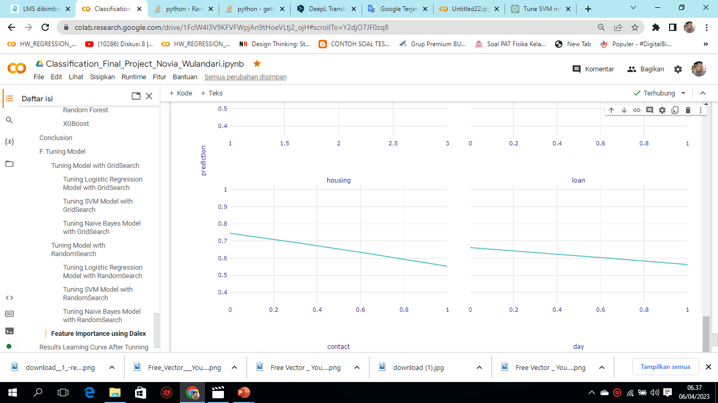
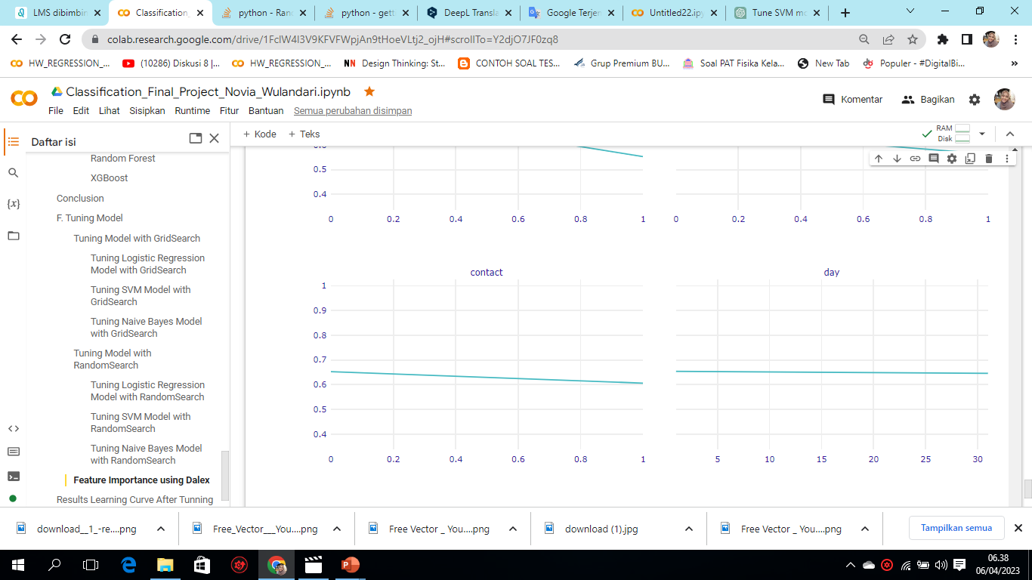
Partial dependence plot of LogReg model for each feature
In housing and loans features , the curve is decreasing, meaning that term deposit customers are decreasing.
In contact feature, the curve is decreasing, meaning that term deposit customers are decreasing.
In day feature, the curve is straight tends to be constant, meaning that this feature does not affect term deposit customers or not.

Slide 29


Partial dependence plot of LogReg model for each feature
In the month feature, the curve rises slightly, meaning that the potential for term desposit customers is getting higher.
In the campaign feature, the curve is decresing, meaning that this feature is getting lower customers who term deposit
In the previous feature, the curve rises slightly, meaning that the potential for term desposit customers is getting higher.
In the poutcome feature, the curve is increasing, meaning that the potential for term desposit customers is getting higher.

Slide 30

Conculusion of Feature Importance with Dalex:
Highly influential features: poutcome, duration, and housing.
On partial dependence for each features. Features duration, balance, job, education, month previous and poutcome the curve rises meaning that it is directly proportional to the deposit, so the potential for term deposit customers is also high.
Features pdays, age, and day are straight curves meaning that it has no effect on whether the customer will term deposit or not.
Features default, housing, loans, contacts and campaigns curve downward, meaning that customers with potential for term deposit are decreasing.
The core feature that must be improved is because the highest feature is poutcome. Poutcome is the result of the previous marketing campaign. While in partial dependence for each features the value of the campaign is decreasing, meaning that the campaign that has been carried out does not increase the number of term deposit customers. means that the thing that must be improved is the way of marketing campaigns to increase deposits.
This photo pinterest.com

Slide 31
E. Conclusion & Recommandation Business Insight

Slide 32
Conclusion
The author split the train & test data at the beginning to avoid data leakage.
The best models Logistic Regression, Naive Bayes, Support Vector Machine, (SVM) were selected because these models have the lowest accuracy difference (below 15%) compared to other baseline models so they were selected for tuning.
The author chooses to determine the best baseline model by looking at the difference in accuracy of train and test data because if you look at accuracy alone it is less precise, this opinion is based on discussions by Rafael in https://www.kaggle.com/datasets/prakharrathi25/banking-dataset-marketing-targets/discussion/308241
So that with a model that is more sensitive to people who will make term deposits, marketing campaigns can be maximized by approaching people who have criteria or tend to make term deposits with various appropriate marketing methods.

Slide 33
Recommendation Bussiness
Business Recommendation Objective: to save on advertising/campaign costs to customers and increase customers who make/Term Deposit subscriptions.
Using a model to create a list of potential customers who want to make a term deposit, so that the marketing department can directly campaign to potential customers in order to save campaign costs.
Create a general guideline for deposit marketing that contains specific criteria that can make customers become uninterested or vice versa to make deposits based on several facts found from the data, then consider the following points to create a general guideline:
Consider campaigning in the 30s.
Consider campaigning for non-divorced couples
Consider looking at the balance rate in each profession, try to approach more customers who work as management
It is not recommended to campaign (contact) customers too often, because the more you contact (campaign / advertise) to customers, the chance for customers to make term deposits is getting smaller.

Slide 34



Do you have any questions?
wulandarinovia663@gmail.com
https://www.linkedin.com/in/novia-wulandari-1247a2228/
https://github.com/noviawulandar1
Credits: this presentation template was creadit by Slidesgo

